Slide 1
Transportation Challenges for Persons Aging with Mobility Disability: Qualitative Insights and Policy Implications
Elena T. Remillard, M.S., Margaret L. Campbell, Ph.D.,
Lyndsie M. Koon, Ph.D. & Wendy A. Rogers, Ph.D.

Slide 2
Background
Many older adults with mobility disabilities lack access to adequate transportation, which can hinder their ability to fully participate in society (Brumbaugh, 2018; Rosenbloom, 2007)
rely on personal vehicles, as drivers or passengers, for the vast majority of trips
low utilization of local public transit, paratransit, as well as as taxi and rideshare services
General transportation challenges among this population include: accessibility, affordability, availability
Need for detailed user insights on the specific issues

Slide 3
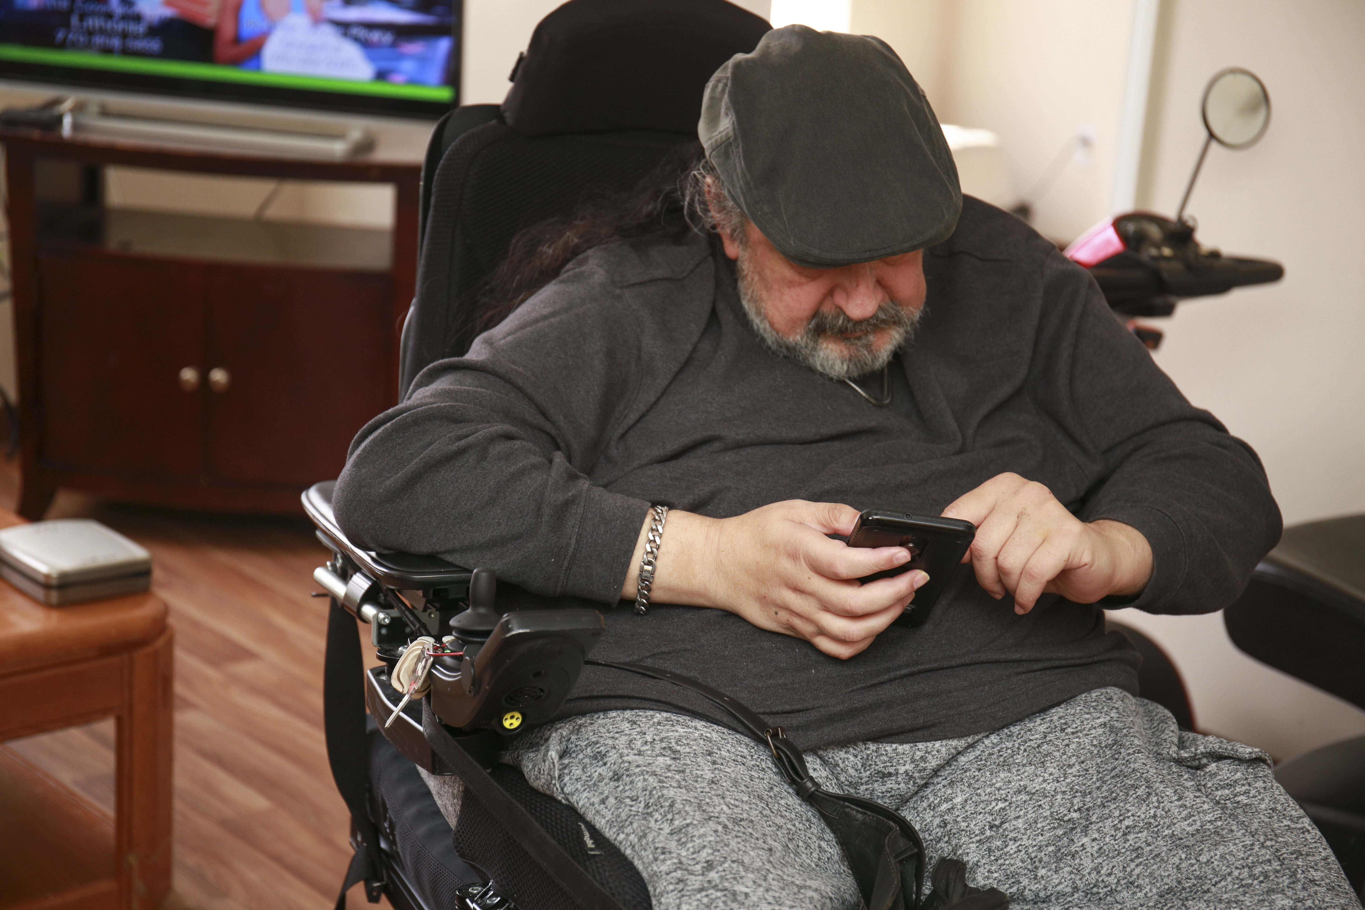
Persons Aging with Mobility Disability (PAwMD)
Transportation challenges are likely to be greater & more complex for PAwMD
Long-term mobility disability
Secondary conditions (e.g., pain, fatigue, depression)
Age-related conditions (e.g., arthritis, hypertension) & declines (e.g., memory, vision, strength)
Socioeconomic disadvantages (e.g., lower income, higher unemployment, and less healthcare access)
Notes:
Challenges are likely to be greater & more complex for older adults with long-term mobility disabilities. Intersection of aging & long-term disability
Collectively, these factors likely contribute to PAwMD being at increased risk of experiencing transportation barriers.

Slide 4
Aging Concerns, Challenges, and Everyday Solution Strategies (ACCESS)
Large-scale, mixed-method study assessing everyday support needs among people aging with disability. Covers a broad range of activities, including transportation.
What is the frequency, nature, and distribution of problems in everyday activities?
What are the response strategies for these challenges (e.g., technologies, tools, assistance from others, own methods)?
Older adults (ages 60-79) with long-term hearing, vision, and mobility disabilities
Phase 1 (N=180)
Low Vision/Blind (n=60)
Mobility (n=60)
Deaf/Hard of Hearing(n=60)
Notes:
TechSAge – User Needs study of individuals aging with disability: ACCESS
Questionnaires + Interview
Covering a broad range of everyday activities, including transportation.
Interview Structure
Participants identify their ‘most difficult’ activity across 6 broad categories (rating activity)
Open-ended questions on their ‘most difficult’ activities:
specific challenges they experience
how they manage them (e.g., assistance from others, use of tools, own methods).

Slide 5
Objectives: Analyze transportation challenges through a policy lens
Transportation challenges among PAwMD
(ACCESS)
U.S. transportation policies and initiatives designed to support them
(FAST Act)
ACCESS data collection occurred in 2015-2019, overlapping with timing of the Fixing America’s Surface Transportation (FAST) Act of 2015
Notes:
Interdigitate micro-level insights with macro level policy.
RQ1) How can user insights on transportation challenges among ACCESS PAwMD highlight gaps in current government policies and programs as well as point to new opportunities to improve transportation services?
RQ2) How do key barriers experienced by state and local providers in implementing and coordinating transportation services for older adults, people with disabilities, and individuals with low income compare to transportation challenges reported by ACCESS PAwMD?

Slide 6
Fixing America’s Surface Transportation (FAST) Act of 2015
$305 billion (in FY16- FY20) for transportation infrastructure planning and investment, including the priority to address the lack of access to reliable transportation among older adults, people with disabilities, and low income individuals.
*See special issue paper for an overview of key FAST Act provisions & programs
Notes:
$305 billion over 4 years for transportation programs, which among other priorities included efforts to support older adults, PwD, and low income individuals
3 provision-2 grant programs – ICAM coordinating infrastructure
In paper, we identify provisions and program initiatives of the FAST Act (Table 1). This involved extensive internet research on the FAST Act and U.S. Department of Transportation websites.

Slide 7
Research Questions
How can user insights from PAwMD highlight gaps in government policies and programs and opportunities for improvement?
How do individual-level transportation challenges among PAwMD compare to barriers to coordinating and implementing transportation programs and services at state and local levels?

Slide 8
ACCESS Participants: 35 female, 25 male
Inclusion Criteria
60-79 years of age (mean 69, SD 5.4)
Self-identify as having mobility impairment – have had the impairment prior to the age of 50
Using a mobility aid (i.e., cane, crutches, wheelchair, walker, or scooter) and having serious difficulty walking or climbing stairs (or unable to walk or climb stairs)
Fluent in English
Live in the United States
Onset age of mobility impairment
Range: Birth – 49 years
Mean Age of onset: 19 years, SD 16 years
Education Level
Range was less than high school to doctoral degree
Modal response was Bachelor’s degree

Slide 9
Analysis of ACCESS Transportation Challenges
Transportation
Arranging for transportation via taxi, Uber or Lyft
Getting a ride from a family member or friend
Riding a train or subway
Taking a bus
Driving
Wayfinding
Flying on an airplane
Walking (as a pedestrian)
*Using paratransit
Method
Building off existing ACCESS coding scheme (Koon et. al, 2020), identified transportation challenges from participants’ discussions of:
difficulty ratings for all transportation activities
challenges and response strategies for ‘most difficult’ transportation activity
satisfaction with transportation overall
transportation challenges for community-based activities (e.g., going shopping, going to entertainment events)
Notes:
ACCESS study covered various modes of transport including….
Our analysis focused on transportation systems and modes for local community participation relevant to U.S. policy (thus excluding flying, walking, wayfinding). Although we did not explicitly ask about paratransit, paratransit challenges emerged in the interviews and are reported here as a distinct mode to convey unique challenges.

Slide 10
Transportation Challenges among PAwMD
“There is one taxi that is sometimes in existence. Usually Uber doesn’t cover, there is no public transportation, there’s no rail, there’s no bus. In the last twenty years, a local transport system for the aged and disabled has been developed. I know virtually nothing about it, I’ve never used it. All transportation that I use is self-provided.” [General transportation]
“I've been injured several times using that service, so I'm afraid of it. There are all these signs about how you have to be tied in, locked in, or whatever, but those are just signs, the people that actually drive the bus don’t care about that at all.” [Riding a Bus]
“I have to be ready at the designated area at least a half an hour before the time that I scheduled for them to pick me up. It’s the same way for coming back…If I’m not at that designated area, they’ll wait just a couple of minutes and then they leave. And there’s no guarantee that they will come back if I call.” [Using paratransit]
“I don’t think they’re used to somebody with a disability traveling, and then traveling alone. Cause every time I go somewhere they say, ‘Who’s with you?’, and I say I’m by myself! They make it seem like, ‘oh, somebody let you out? In public by yourself? Oh no!” [Arranging transportation via taxi, Uber or Lyft ]
“I break the chair down and put it in the car. Now, the shoulders being shot, it hurts a little bit every time I do it.” [Driving]
Sometimes the only accessible transportation in town is like a wheelchair van, medical type service and those are prohibitively expensive, like unbelievably expensive.” [Using paratransit]
Lack of availability
Accessibility
Safety
Physical limitations and health concerns
Financial limitations
Advanced planning and amount of waiting required
Societal attitudes
Notes:
Started with existing ACCESS coding scheme for challenges (e.g., accessibility, safety), but also identified new themes (e.g., societal attitudes)

Slide 11
In-Depth Look at Accessibility Challenges
“There’s been times I’ve called for a taxi and explained [that I need] a vehicle that is a standard sedan where the seat is pretty level with where my wheelchair seat… I get out there and it’s a minivan or a van and there’s just no way I can transfer that high into a seat.” [Taxi]
Accessibility
Transferring
Steps and stairs
Limited access to accessible vehicles
Wheelchair access and storage
Lack of handicap accessible spaces
“I have to plan the activity and then I have to rely on the availability of parking.” [Driving]
“A lot of [train] stops would not be wheelchair accessible…I don’t think I’m going to walk down subway stairs… it would have to have a lift.” [Riding a train, bus or subway]
“When the bus pulls up to the curb, and there’s another wheelchair on there, I cannot get on. I have to wait for the next bus. That’s an inconvenience.” [Riding a bus]
“Calling and scheduling Uber and Lyft or taxis is very simple…Getting the service is a difficult aspect, because it’s dependent on the number and the existence of accessible vehicles.” [Rideshare]

Slide 12
Top 10 Barriers to Coordination of Transportation Services Reported by State and Local Employees
1: Limited Awareness of Federal Funding Sources and Policies
Interagency Transportation Coordinating Council on Access and Mobility (CCAM) Top 10 Ranked Barriers to Coordination of State and Local Transportation Services for Three Target Populations of Older Adults, Individuals with Disabilities, and Low-Income Persons based on State and Local Focus Groups and a National Survey of Transportation and Human Services Organization Employees Conducted in 2018(¹)
2: Unengaged Stakeholders and Difficulties Establishing Community Partnerships
3: Program Restrictions
4: Insufficient Incentives or Financial Motivation to Coordinate Services
5: Limited Federal Guidance to Support Coordination
6: Jurisdictional Boundaries Among Cities, Counties and Regions
7: Administrative Burden & Staff Shortages
8: Insufficient Data to Demonstrate Utility of Transportation Coordination
(¹)Sources: A U.S. Department of Transportation series of focus groups conducted spring of 2018 with transportation and human services stakeholders on behalf of the Interagency Coordinating Council on Access and Mobility (CCAM) and a nationwide survey conducted by the National Center for Mobility Management (NCMM) as reported in the CCAM Report to the President (September 2020) In response to: Fixing America’s Surface Transportation Act Section 3006(c)(4)
9: Concerns About Cost Sharing and Local Matching Funds
10: Lack of Accessible Vehicles and Inaccessible Systems
Notes:
In the paper, we looked at how these coordination barriers at the state & local level might correspond to challenges to the individual user-level challenges to accessing and utilizing transportation reported by individuals aged 60-79 with long-term mobility disabilities in the ACCESS study.

Slide 13
A: Top 10 Barriers to Coordination of Transportation Services Reported by State and Local Employees
B: Transportation Challenges Reported by People Aged 60-79 with Long-Term Mobility Disabilities in ACCESS Study
A1: Limited Awareness of Federal Funding Sources and Policies
B1: Shortage of Accessible Transportation Options Both Public (e.g., bus, rail, paratransit) and Private (taxi, Uber/Lyft)
A2: Unengaged Stakeholders and Difficulties Establishing Community Partnerships
B2: Inaccessible Transportation Features
A3: Program Restrictions
B3: Safety
A4: Insufficient Incentives or Financial Motivation to Coordinate Services
B4: Physical Limitations and Health Concerns
A5: Limited Federal Guidance to Support Coordination
B5: Financial Costs/Affordability
A6: Jurisdictional Boundaries Among Cities, Counties and Regions
B6: Amount of Advanced Planning and Waiting Required
A7: Administrative Burden & Staff Shortages
B7: Societal Attitudes/Ableism
A8: Insufficient Data to Demonstrate Utility of Transportation Coordination
A9: Concerns About Cost Sharing and Local Matching Funds
A10: Lack of Accessible Vehicles and Inaccessible Systems
Notes:
Areas of potential correspondence between (Column A) barriers to coordination of state and local transportation services for older adults, people with disabilities, and individuals from low- income backgrounds (Column A) and personal challenges to accessing and utilizing transportation reported by individuals aged 60-79 with long-term mobility disabilities in the ACCESS study (Column B). Linkages were made based on two criteria: 1) cause and effect relationships 2) and similar language or concepts. Linkages with an explicit cause and effect relationship AND similar wording were labeled as ‘direct’, whereas linkages with either an explicit cause and effect relationship OR similar wording were labeled ‘indirect’.

Slide 14
Take Aways
Many transportation barriers PAwMD experience are related to accessing modes of transportation that can safely and effectively accommodate mobility aids.
Public: need to expand wheelchair seating availability; provide wheelchair securement training for drivers; reduce service restrictions of paratransit
Private: need to expand availability of wheelchair accessible vehicles in taxi and rideshare services; PAwMD need alternatives to driving or relying on rides from family/friends
Complex requirements and limited guidance of federal transportation initiatives, like the FAST Act, → barriers in service implementation → challenges experienced by end users
Importance of engaging both service providers and end-users with disabilities into the transportation policy development and program implementation

Slide 15
Thank you
Elena Remillard, M.S.
Elena.Remillard@design.gatech.edu

