Slide 1
Three Decades Of Participatory Action Research on “Real Choice”: What Have We Learned about
Community Living & Participation
Disparities & Interventions
WITH Diverse People With Disabilities & Communities
Community Living & Participation State of the Science, Sept. 2021
Presentation by Joy Hammel
A PAR Partnership between: Disability Rights Communities & University of Illinois at Chicago and ADA PARC Participatory Action Research Networks

Slide 2
Funding
This research was funded by:
  National Institute on Disability, Independent Living and Rehabilitation Research (NIDILRR)
    Stepping Stones Field-initiated Research: #H133G0100383
    RRTC on Aging with Developmental Disabilities: #H133B080009
    RRTC on Promoting Integration for Stroke Survivors: Overcoming Societal Barriers: #H133B031127
    Americans with Disabilities Act Participation Action Research Consortium DRRP: #90DP0026 and 90DPAD0001
  State of Illinois Medicaid
  UIC Institutes
    Policy and Civic Engagement
    Race & Public Policy

Slide 3
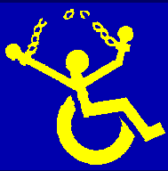

Multifaceted Interventions on Community Living & Participation (CLP)
  Focused on people with disabilities trying to:
    move out of nursing homes and institutions,
    live in the community long term, and,
    prevent costly and unwanted future institutionalization
  Based on civil right to live and participate in communities of choice with supports
    ADA & Olmstead
    Medicaid home & community-based services and supports

Slide 4
Multifaceted Interventions on CLP-2
  Especially focused on people who experience disparities and inequitable access to these rights, supports and services
    Living in poverty and qualifying for Medicaid HCBS
    Representing people who identify as Black, Latinx and from other underrepresented social groups and intersecting identities
  Cross disability groups and identities

Slide 5
Three Examples
Stepping Stones project (RCT with n=140 + continued funding from Illinois Medicaid to >800)
  Cross disability
ATLAS & PEP projects with People with IDD (RCT with n=75; community advocacy program with n=400)
IPASS project with People with Stroke (RCT with n=140)

Slide 6
What do they share?
  Participatory Action Research approach with community as full partners in:
    defining community living and participation needs, issues, strategies, strengths and assets
    designing & delivering interventions
    acting on findings to change systems and build community capacity
  Rigorous qualitative, quantitative and action research methods and analyses
    Need a combo to impact systems and policy changes

Slide 7
PAR Process-1
Prior to intervention testing
  Community Action Team Design funded by grants
  Participatory Appreciative Inquiry focus groups co-led by community experts/peer mentor facilitators as paid members of research team
  Participatory community assessments and consumer directed goal setting & outcome reporting
  Consumer-directed assessments of CLP outcomes
    Community Participation Indicators (CPI) assessment
    Community Participation Self Efficacy assessment
    CMS QOL survey

Slide 8
PAR Process-2
  During Intervention Testing
    Designed & Tested Multifaceted CLP intervention together
      Based on social model of disability, social ecological & social learning theories
      Co-facilitated by Community Peer Mentors & Disability Studies PAR researchers
      Individual Guided Discovery coupled with Group Social Learning
        Problem solving, confidence building, active & transformative learning
      Participants learn how to manage, advocate for and change environments, and increase access to civil rights as a collective community
        Focus on building community empowerment at same time as individual self advocacy and self determination

Slide 9
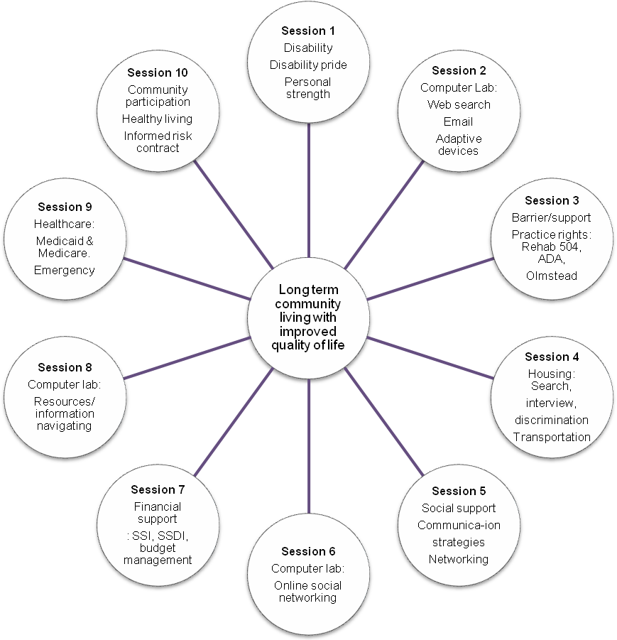
Examples: Stepping Stones

Slide 10
Examples: Improving Participation after Stroke Self Management Program (IPASS)

Slide 11
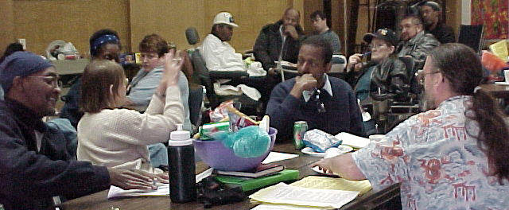
PAR Process-3
Moving to action during and after interventions
  Findings and outcomes summarized in accessible language and shared back with community
    Infographics, fact sheets, accessible community reports, video documentaries, social media
  Community Town Halls to action plan as a community and to get policy makers and other key stakeholders to understand issues and respond to them in public
  Long-term Systems Change to move programming to community delivery as part of HCBS
  Findings used in civil rights legislation and legal cases

Slide 12
Significant Findings
Improved CLP choice & control
Improved CLP goal attainment
Improved CLP engagement & satisfaction
  E.g., being able to do what you want or need to
    What, when and with whom
Improved community enfranchisement
  E.g., equitable access to opportunity and resources, choice & control, community membership & social networking, voice, freedom, respect & dignity
Improved physical and mental health management

Slide 13
Where are we headed?
Large scale complex, tailored intervention testing embedded in a strong PAR community approach
Long term systems and policy changes with disability rights communities
Documenting and acting on social justice participation disparities nationally in ADA PARC at adaparc.org
  Community Living
  Community Participation
  Economic Equity

Slide 14
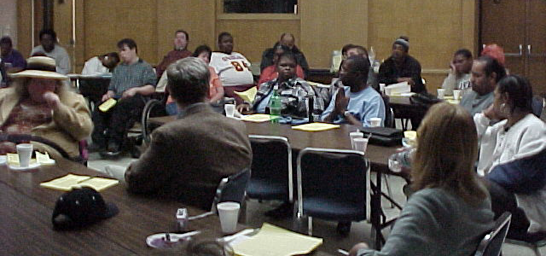
Much thanks to…
The many communities of learning, activism & action research collaborating and guiding us across local, state and national levels
The many people with disabilities holding us accountable, supporting each other, and taking action to make the change happen
For more information and access to references and resources from this PAR collaboration, contact Joy Hammel at hammel@uic.edu

