Slide 1
The Presents: A Community Living Summit
This virtual presentation is funded through a grant from the National Institute on Disability, Independent Living, and Rehabilitation Research (NIDILRR grant number 90RT5043). NIDILRR is a Center within the Administration for Community Living (ACL), Department of Health and Human Services (HHS). The content of the presentation does not necessarily represent the policy of NIDILRR, ACL, or HHS, and you should not assume endorsement by the Federal Government.

Slide 2
>> SLIDE 2: Thank You to our Scientist-Consumer Advisory Panel (SCAP) Members:
Brian Abery
Fabricio Balcazar
Ron Garcia
Catherine Graham
David Keer
Sierra Royster
Phil Rumrill
Tom Seekins
Jack Stratton
Ranita Wilks

Slide 3
>> SLIDE 3: Community Living and Participation (CLP)
Social connections play an important role in our overall well-being and quality of life
Lack of these connections is associated with negative physical and mental health outcomes
CILs play a critical role in supporting CLP for people with disabilities
Research shows that people with disabilities who have more usable homes (e.g., in their bathrooms) are more likely to participate in the community
Research shows that self-determination skills such as choice making, self-advocacy, and self-management are positively associated with better community participation outcomes

Slide 4
>> SLIDE 4: What is PICL?
The PICL project tested two CLP programs at six CILs across the country
The “PICL program” consists of two consumer-directed programs designed for people with mobility disabilities:
The Home Usability Program
Goal-setting program to make a person’s home more usable
Out and About
Goal-setting program related to community participation
Overall goal:
To increase the community participation of people with mobility disabilities

Slide 5
>> SLIDE 5: Agenda for today
This forum will provide information about the programs, how Centers can use them, and important resources that are available.
Home Usability Program – Lillie Greiman
Out and About Program – Kelsey Goddard
National Community Living Resource Center – Ryan Henley
The accessABILITY Experience – Tammy Themel, Keshia Walker, & Susan Ferguson
Consumer Case Studies – Randi Gray & Lyndsie Koon

Slide 6
>> SLIDE 6
Home Usability to Support Community Living
Results and Next Steps from the PICL project
“It’s life changing!”
–Consumer participant

Slide 7
>> SLIDE 7: The Home Usability Program
Usability vs. Accessibility
Low-cost modifications, assistive technology, supports
$350 per consumer
Consumer driven
Our research question: Does participation in a consumer directed home usability intervention increase community participation for consumers with mobility disabilities?
Outcome data collected:
Community participation-trips and activities in the community
Levels of pain and exertion
Health

Slide 8
>> SLIDE 8: HUP Methods & Implementation
Program content developed with a team of 5 CIL specialists from 5 different centers as part of pervious funding
Consumers work closely with CIL staff to work through intervention online or with printed manuals
Consumers complete a home usability plan throughout the process
Home usability quiz
Home usability self assessment-AARP Home Fit Guide
Resources (social and financial)
Included a home visit by CIL staff when feasible
Results presented here from phase one in 2017-2019
195 consumers participated in a random control trial across two CILs
81 completed the Home Usability Program

Slide 9
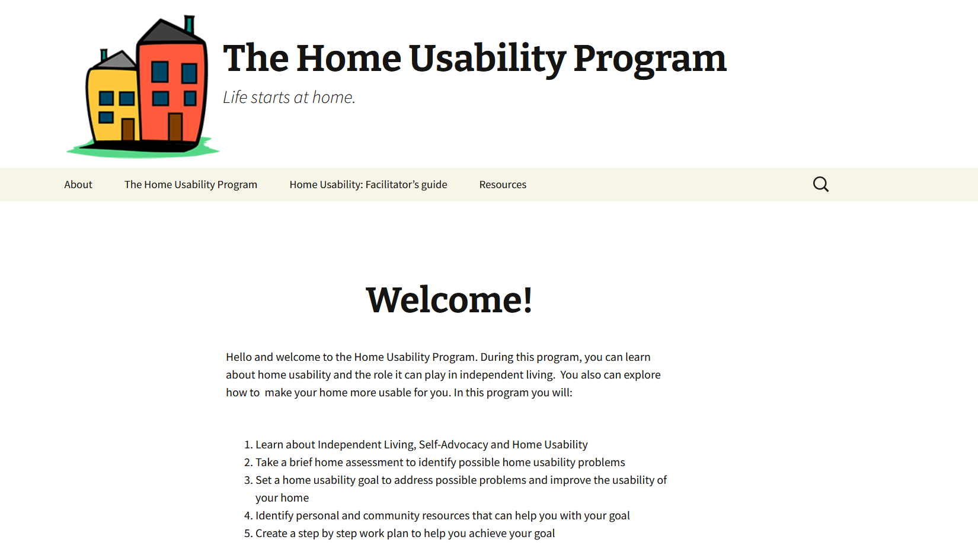
www.useablehome.com

Slide 10
>> SLIDE 10: Home Usability Projects
Bathing and grooming: Grab bars, shower chairs, non-slip mats
Cleaning: Robot vacuums, long handled dusters, storage
Mobility: Mobility devices such as walkers and canes
General safety: Fire extinguishers, medical alert device
Entrancing: Hand railings, video doorbells, threshold ramps
Cooking: Adaptive cooking equipment
Sleeping: New mattress
Moving: Moved to a more accessible space
Dressing: Assistive equipment
Furniture: lift recliners, accessible desk
Assistive equipment: Reacher tool

Slide 11
>> SLIDE 11: Results
Consumer directed home usability changes positively impacted participation in social and recreational activities
Program participants reported a 39.5% (p < .05) increase in social and recreational activities immediately following the intervention relative to the control group after controlling for health status and month
Bathroom, safety and sleeping changes seem to have the greatest impact

Slide 12
>> SLIDE 12: Home Usability Program Quotes
“[The Home Usability Program] kind of gave me a sense of if I were to do even more accessibility modifications to my home, kind of the process, kind of what I would need to think about and go through, prior to making that happen. So, making sure I have the money set aside, obviously, but also contacting people, getting different estimates, and things like that.”
“I learned how to better ask some questions. I also learned that there are resources available that you might not initially think of.”

Slide 13
>> SLIDE 13: Success Strategies
Community relationships and local partnerships
Furniture stores and durable medical equipment providers
Hardware stores, contractors/handymen
Habitat ReStores, Home Depot foundation grants
National/local nonprofit organizations
Thrift/resale stores (vouchers and discounts)
City governments
Amazon wish lists and donation drives
AT loan closets and AT loan/grant programs (State AT programs)
Data communication and program marketing

Slide 14
>> SLIDE 14
Questions?

Slide 15
>> SLIDE 15
The “Out and About” Program Life Expands in the Community
Results and Next Steps from the PICL project

Slide 16
>> SLIDE 16: The “Out and About” Program
Consumer-driven goal-setting program to increase community participation
Learn what consumers want to do in the community
Empower consumers to set goals and achieve them
Facilitate consumers in breaking down barriers to get out and about
Our research question: Does participation in a consumer-directed community participation intervention increase community participation for consumers with mobility disability?

Slide 17
https://outandabout.ku.edu
Notes:
Link out to website to highlight resources

Slide 18
>> SLIDE 18: Out and About (OAA) Steps
Meeting 1
Choosing a Goal
Identifying Resources
Meeting 2
Setting a SMART Goal
SMART Goal Tracking
Weekly Check-In
Tracking Weekly Progress
Final Meeting
Reviewing and Celebrating Progress

Slide 19
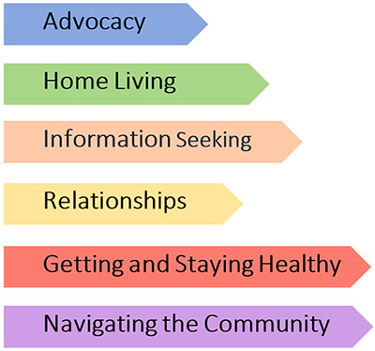
>> SLIDE 19: Out and About
Goal Area | OAA Goal
Getting healthy | Going to the gym and identifying supports to join them
Transportation | Using the paratransit system for the first time
Notes:
Resouces per goal setting category
To help ppl to select diff goals, we provided a varity of resources for the following categories to help them set and work towards their goals.

Slide 20
>> SLIDE 20: Out and About Projects
Attending a neurodiverse group
Professional house cleaning
Reliable transportation
Going to church online
Getting a service animal
Socializing / meeting other people
Using social media to stay in touch
Learning to use a sewing machine
Getting a laptop
Engaging in social media
Decorating for holidays
Medication delivery system
Food delivery systems
Trivia night
Going out in the community
Fishing trips
Exercise equipment
Art class
Typing to decrease fatigue
Volunteer opportunities

Slide 21
>> SLIDE 21: PICL During the Pandemic
Implications of the coronavirus pandemic on PICL:
Measures of physical participation in the community not as meaningful
People electing not to physically participate in their community
Community participation as a “luxury”
More people in emergency crises during the pandemic
Increased attention to meet basic needs
Solutions:
Increased interviews to assess effects of PICL program on consumer’s lives
Pivot to “community participation from home”
Learning from CIL staff about the needs of their consumers

Slide 22
>> SLIDE 22: Out and About Quotes
“So, I think definitely the best thing was just kind of the connection with other people. I feel like it really has for me, at least increased a little bit during this COVID-19 pandemic… we all want to make sure that we stay connected because it can get very lonely when you’re either by yourself or with the same group of people constantly.”
“[I learned] new information, learning about organizations that I didn't know were there. Kind of prompting me to actually do a little research of my own. Because otherwise I wouldn't have thought about looking up anything about food assistance or mobile meals or anything like that. So, it was good, excellent for information, because someday I may need it.”

Slide 23
>> SLIDE 23
Questions?

Slide 24
>> SLIDE 24
National Community Living Resource Center
August 17, 2022
Ryan Henley
Notes:
Hi everyone! Welcome to the presentation on the National Community Living Resource Center (NCLRC)! We are excited to have you join us for this presentation! My name is Ryan Henley, and I will be walking you all through how our center works and what it looks like via our website. When we get to the end of this presentation, we will hope to use that time to answer any questions you all may have for us that we shall answer for you.

Slide 25
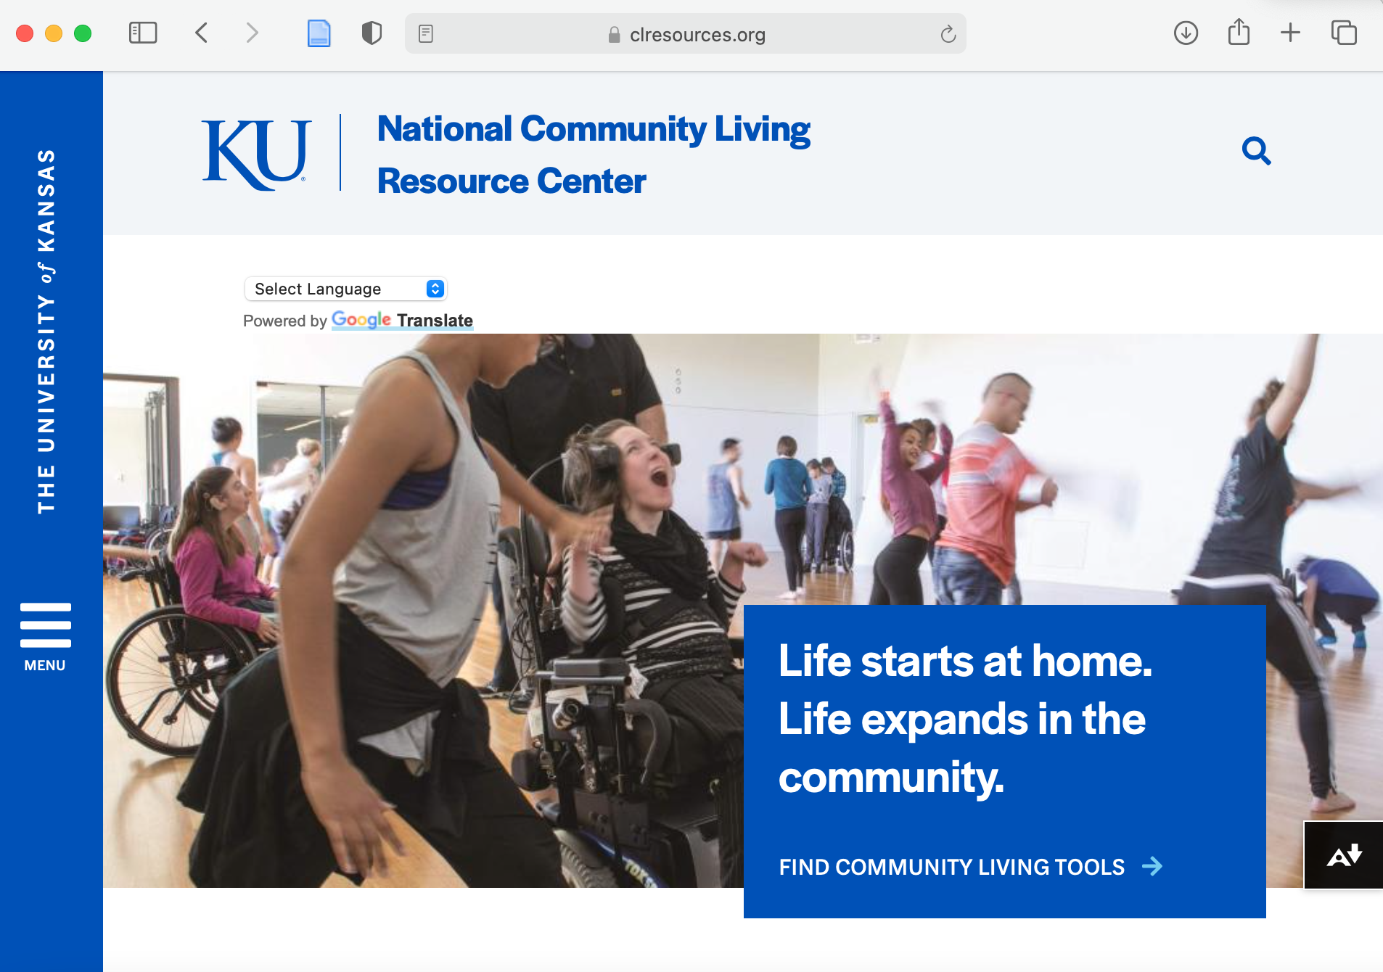
>> SLIDE 25: National Community Living Resource Center (NCLRC)
What is the NCLRC?
A database of interventions of proven value to researchers, consumers, CILs, and others who promote community living for people with disabilities
https://clresources.org
Notes:
So, what is the NCLRC?
It is a database of interventions of proven value to researchers, consumers, CILs, and others who promote community living for people with disabilities. A link is provided on this slide to the website which I can also provide here in the chat.
NOTE: This website was developed under the RTC/PICL; This website continues to be updated and augmented

Slide 26
>> SLIDE 26: Curated Resources
We selected some of the best available resources that align with our review of the research on improving community living for people with disabilities.
For each resource we tell you:
What the resource is
Why we chose to include it
Who benefits from it
How it can be used
We also provide a link to the resource or a site where you can access the resource in full.
Notes:
In terms of curated resources, we have selected some of the best available resources that align with our review of the research on improving community living for people with disabilities.
For each resource we tell you:
What the resource is
Why we chose to include it
Who benefits from it
How it can be used
We also provide a link to the resource or a site where you can access the resource in full. Once again, we will provide those resources in the chat for you all.

Slide 27
>> SLIDE 27: Resource Lists
Advocacy
Community Living Skills
Daily Living
Disaster Preparedness
Employment
Financial
Health
Housing
Legal
Personal Care Attendants
Service Animals
Transition
Transportation
Notes:
On this slide, we list several resources and list them into these following items. While these lists contain many useful resources, we wanted to focus on these three topics underlined: advocacy, community living skills, and health. We believe these topics are the main aspects of community living.

Slide 28
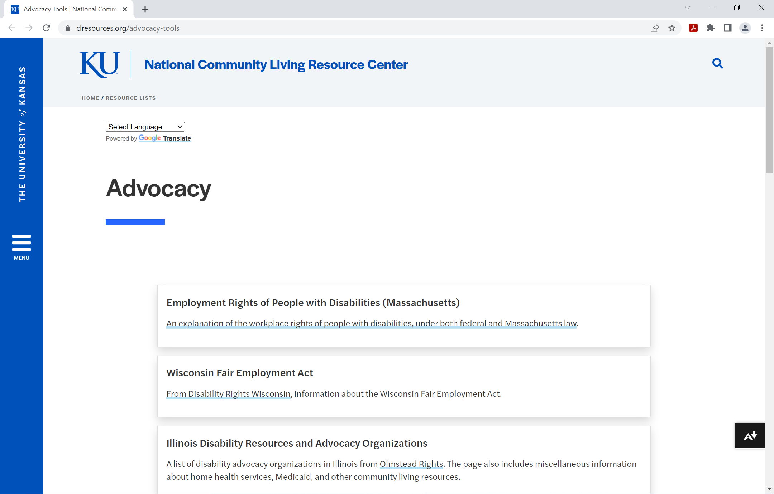
>> SLIDE 28: Advocacy Resources https://clresources.org/advocacy-tools
State Protection and Advocacy Systems created by the Administration for Community Living (ACL)
Self Advocacy Guides created by Disability Rights of Pennsylvania
Advocacy Skill Building Toolkit created by the University of Montana
For more advocacy resources, visit our website!
Notes:
State Protection and Advocacy Systems created by the Administration for Community Living (ACL)
Resource that provides information about the four ACL protection and advocacy programs
Self Advocacy Guides created by Disability Rights of Pennsylvania
Offers guides on abuse, neglect, and exploitation; the ADA; assistive technology; education; employment; housing; and incarceration
Advocacy Skill Building Toolkit created by the University of Montana
Provides materials for CIL staff to lead interactive workshops that introduce and teach advocacy skills
For more advocacy resources, visit our website!

Slide 29
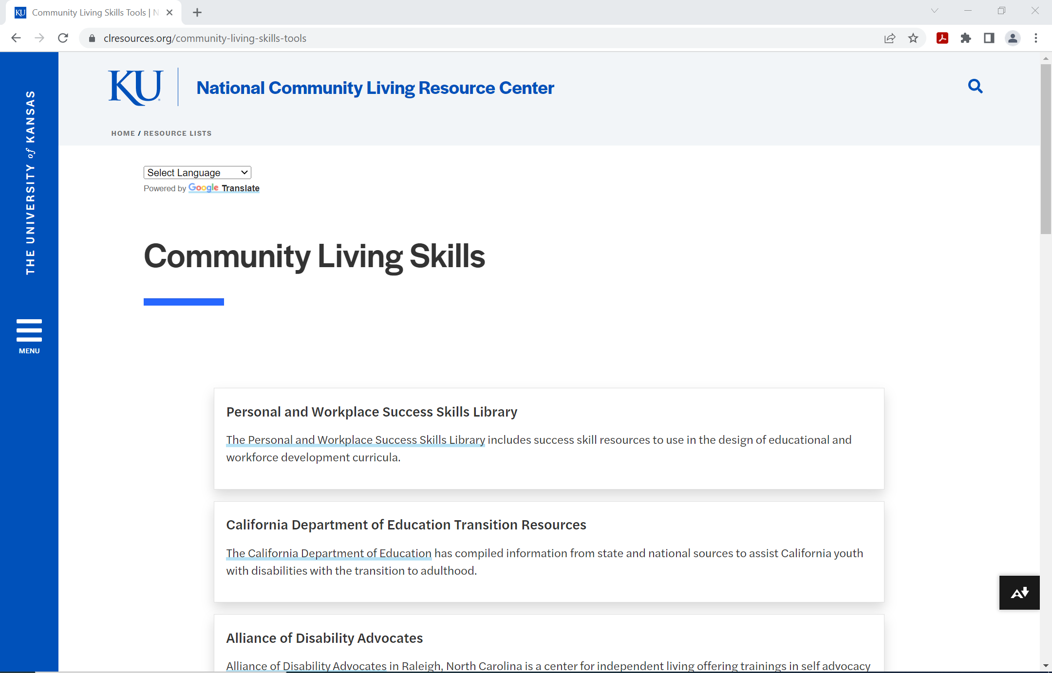
>> SLIDE 29: Community Living Skills Resources https://clresources.org/community-living-skills-tools
Planning for Community Living created by the National Parent Center on Transition and Employment
Administration for Community Living Program Areas created by the Administration for Community Living (ACL)
Healthy Community Living site created by the Healthy Community Living (HCL) program
For more community living skills resources, visit our website!
Notes:
Planning for Community Living created by the National Parent Center on Transition and Employment
Tools for youth-to-adulthood transition planning and developing self-determination
Administration for Community Living Program Areas created by the Administration for Community Living (ACL)
Manages a variety of programs supporting community living options for older adults and people with disabilities
Healthy Community Living site created by the Healthy Community Living (HCL) program
Program about all people having opportunities to live well and participate fully in their communities and was created to be delivered by CILs
For more community living skills resources, visit our website!

Slide 30
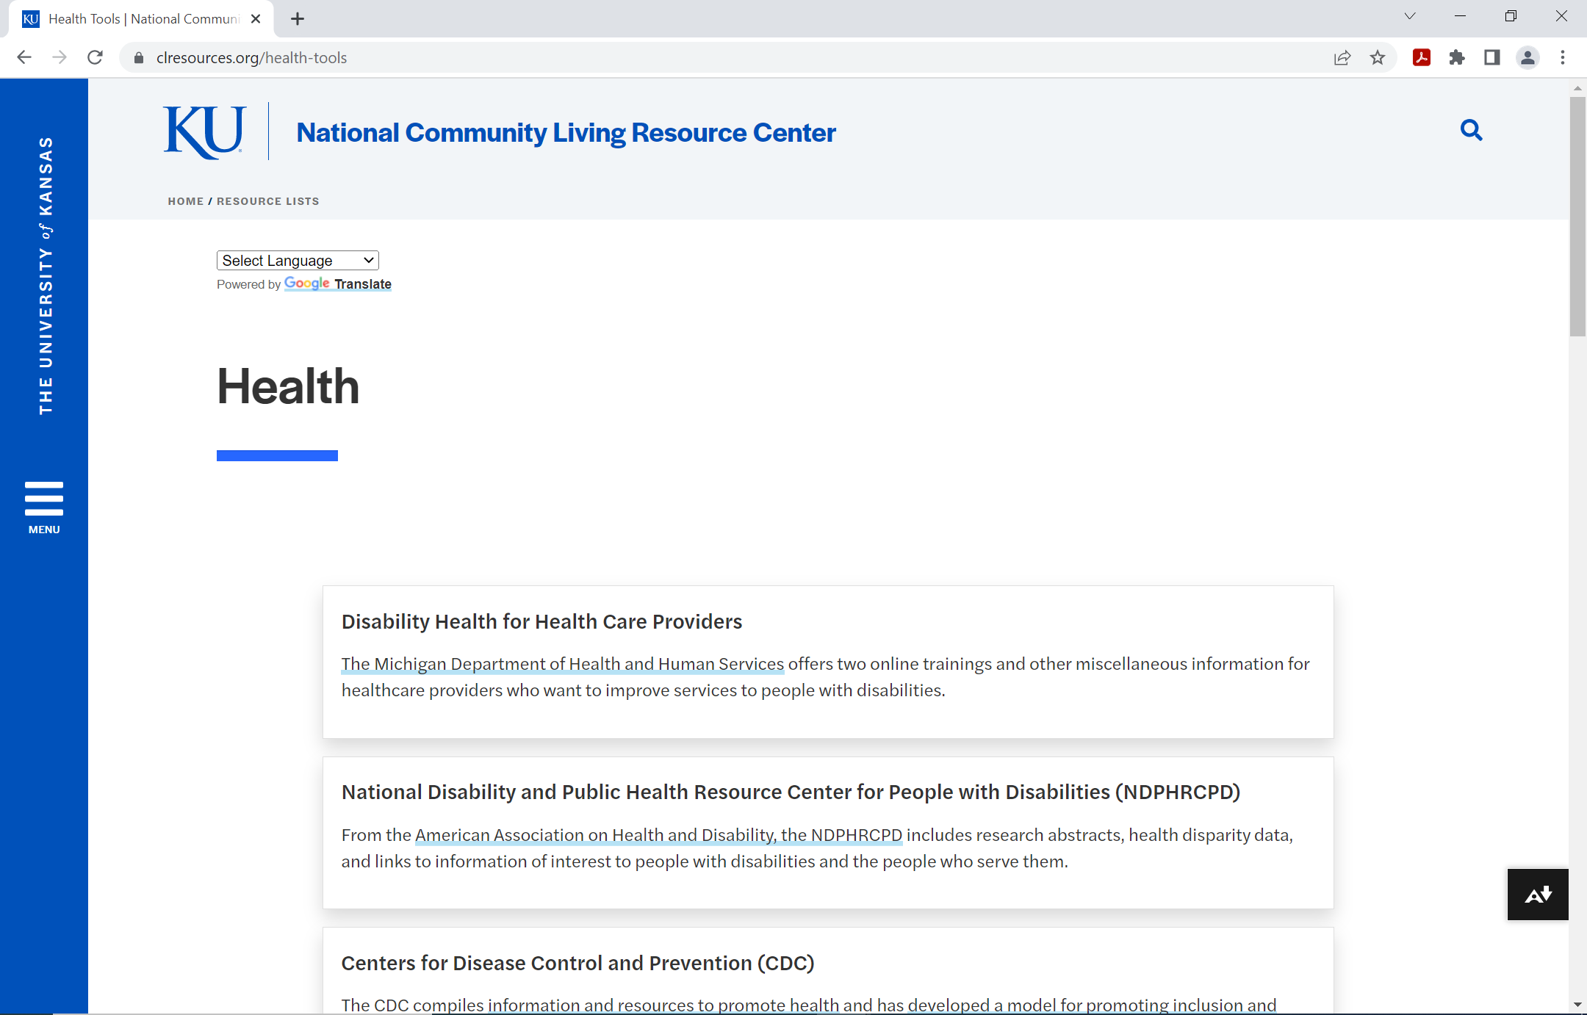
>> SLIDE 30: Health Resources https://clresources.org/health-tools
National Disability and Public Health Resource Center for People with Disabilities (NDPHRCPD) created by the American Association on Health and Disability
Rehabilitation and Choosing a Facility created by the Christopher Reeve Foundation
Improving Access to Health Care for People with Disabilities created by the Disability Rights and Educational Defense Fund
For more health resources, visit our website!
Notes:
National Disability and Public Health Resource Center for People with Disabilities (NDPHRCPD) created by the American Association on Health and Disability
Includes research abstracts, health disparity data, and links to information of interest to people with disabilities and the people who serve them
Rehabilitation and Choosing a Facility created by the Christopher Reeve Foundation
Addresses frequently asked questions about choosing a rehab center and understanding the services that can be provided
Improving Access to Health Care for People with Disabilities created by the Disability Rights and Educational Defense Fund
Helps CIL staff to develop capacity to help people with disabilities access health care and long-term services and supports (LTSS)
For more health resources, visit our website!

Slide 31
>> SLIDE 31: Resource Lists
Advocacy
Community Living Skills
Daily Living
Disaster Preparedness
Employment
Financial
Health
Housing
Legal
Personal Care Attendants
Service Animals
Transition
Transportation
Notes:
Like we said earlier, even though every one of these topics are important for listing resources, we believe that advocacy, community living skills, and health are the three important aspects when it comes to the resource lists and community living.

Slide 32
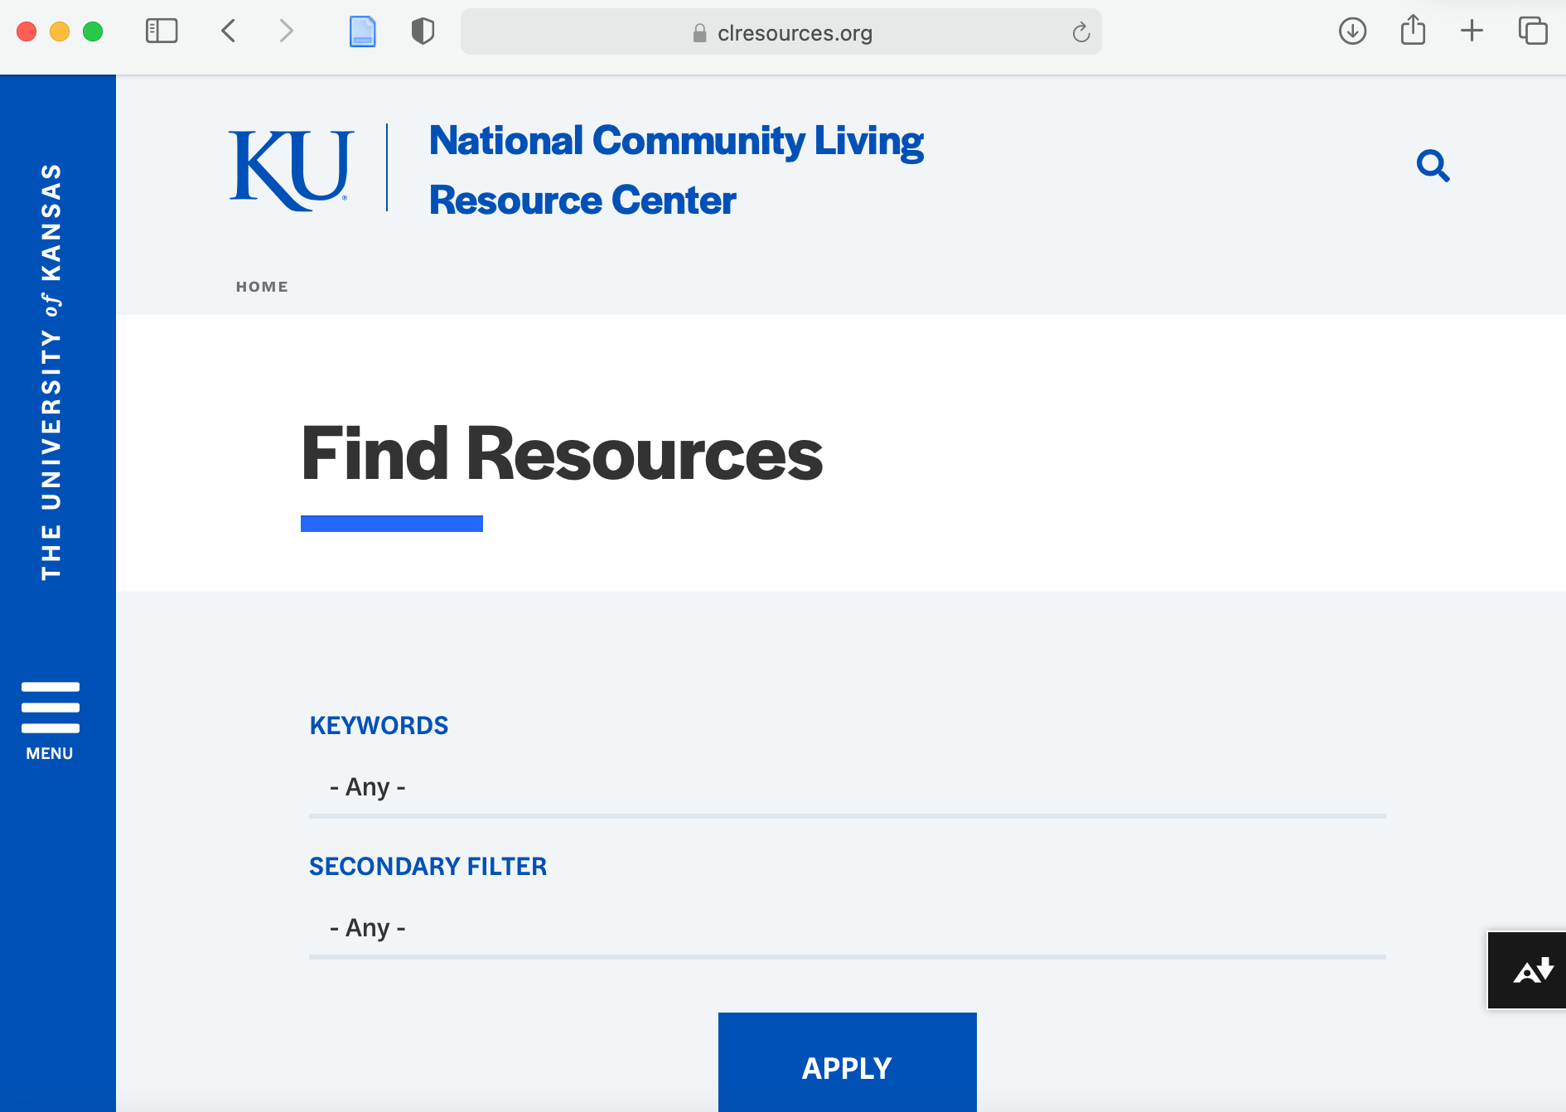
>> SLIDE 32: Find Resources
A search tool is available on our website under “Find Resources”
Can filter by specific keywords and resource type
Notes:
Another way of finding resources is using a search tool that is available on our website under the “Find Resources” section. With this tool, you can filter by specific keywords and resource type to find what you need that is available.

Slide 33
>> SLIDE 33
Questions?

Slide 34
>> SLIDE 34
PICL at accessABILITY

Slide 35
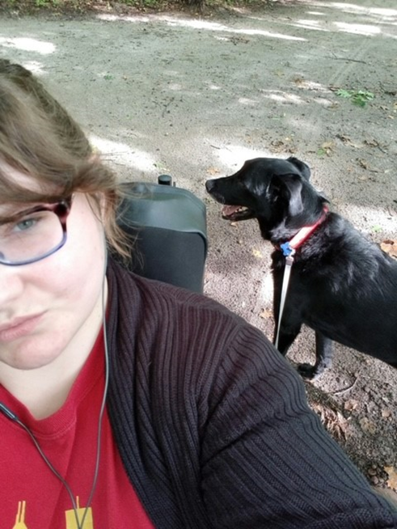
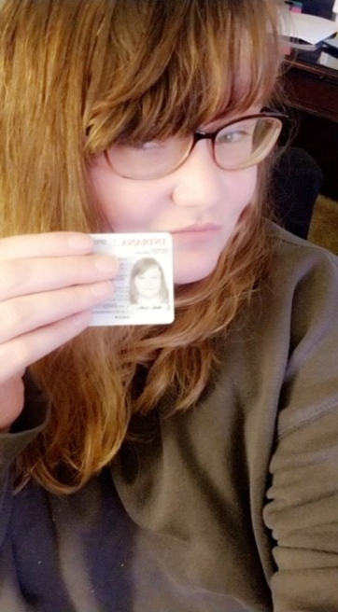
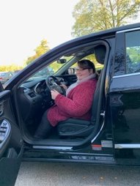
>> SLIDE 35: Working with Consumers
Notes:
KW – PICL got me my job
Incorporating PICL into the accessABILITY culture was seamless. Having the opportunity to fund the unique needs of our consumers was such a great privilege and allowed us to look beyond keeping our consumers independent, but opened the perspective of the different ways we could consider their safety, pain and fatigue while empowering them to lead independent lives.
The PICL Program also allowed us to look at our consumer care in a different light. Instead of frequent check in's from an advocate, we empowered our consumers to log their progress that they made towards their goals. While this collected the research, we became aware of how inspired and motivated they were while taking charge of documenting their developments.
The consumers actively talked with their advocate about the hard work they were putting towards their goals, brainstormed together how they could overcome obstacles and barriers they faced along the way, and celebrated all their success and achievements as they met their milestones.

Slide 36
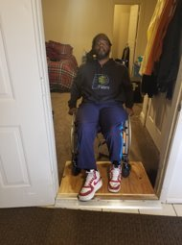
>> SLIDE 36: Working with Consumers
accessABILITY and PICL procedures
Autonomy and motivation
“[My CIL staff] is an angel. You don’t meet too many people like that, with authentic empathy for people.”
Notes:
KW – PICL got me my job
Incorporating PICL into the accessABILITY culture was seamless. Having the opportunity to fund the unique needs of our consumers was such a great privilege and allowed us to look beyond keeping our consumers independent, but opened the perspective of the different ways we could consider their safety, pain and fatigue while empowering them to lead independent lives.
The PICL Program also allowed us to look at our consumer care in a different light. Instead of frequent check in's from an advocate, we empowered our consumers to log their progress that they made towards their goals. While this collected the research, we became aware of how inspired and motivated they were while taking charge of documenting their developments.
The consumers actively talked with their advocate about the hard work they were putting towards their goals, brainstormed together how they could overcome obstacles and barriers they faced along the way, and celebrated all their success and achievements as they met their milestones.

Slide 37
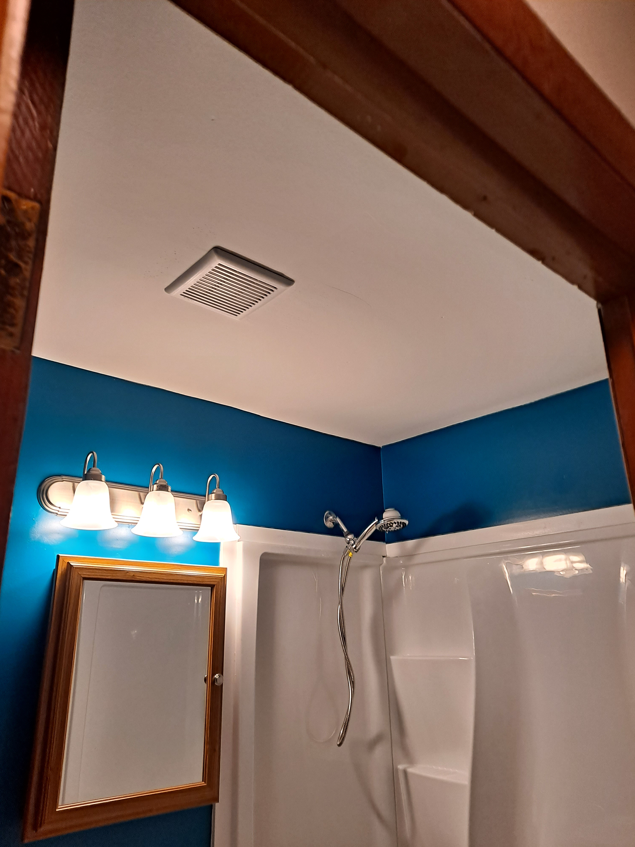
>> SLIDE 37: Identifying Funding
CARES Act Funding
Partnerships with handy people
Launching fundraising
Covering an insurance deductible
Notes:
Identifying funding – CARES Act

Slide 38
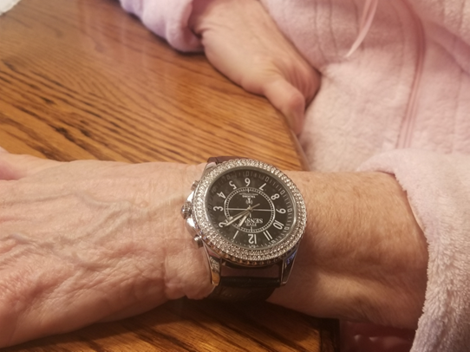
>> SLIDE 38: Barriers
Mid or high-risk outreach
Project budgets
COVID challenges
Access to technology
Basic needs
Notes:
KW - We scrambled to accommodate and innovate ways in which we could stay connected to our community and remain safe. Many of the consumers were discouraged and struggled with their mental health during these challenging times. We quickly started changing the check in phone calls to zoom calls (often times this was the only socialization the consumers would have for the day.) When the project resumed the goals shifted from engaging in their community, to attending virtual gatherings (ie. Church, support groups) and bettering their physical health. Many of our consumers asked to put their stipend towards gym equipment and technology.
Barriers- not being able to visit consumers, research pause after the pandemic
COVID: Isolation, basic needs, increase in virtual peer support

Slide 39
>> SLIDE 39: Testimonials
"Thank God they got organizations like you guys. Like, there’s not too much out there for people with disabilities, you know? And either you’ve gotta have a will of iron to see through it all, or you know, get a little help up from organizations.”
“With the Home Usability Program, I felt like… I was going to feel better. I felt more optimistic about my health. I felt like it was making a difference."
“I learned that I could do more than I thought I could do.”
“I learned how to better ask some questions.”

Slide 40
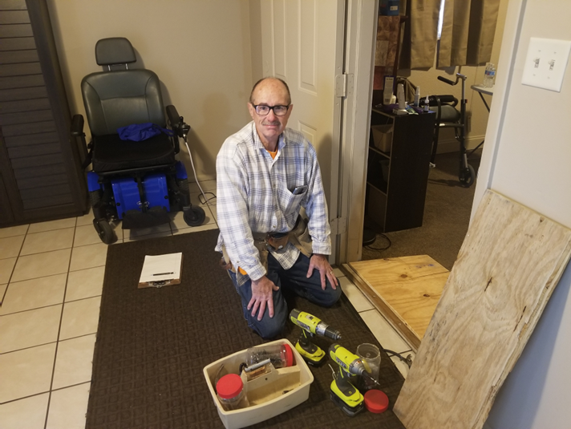
>> SLIDE 40: The Future
Home Modification Committee
Fundraising
Continuing to build partnerships
Seeing this as a barrier buster
Notes:
KW - The ‘Home Usability Program’ and ‘Out And About’ concepts are the backbone of Centers for Independent Living mission. Our consumers work with their advocates on identifying their personal goals and are exclusively in control of the outcomes. The model for independent living is to ensure that our consumers are able to maintain control of their independent lives, which aligns with the PICL goal of reducing fatigue, increasing/conserving energy, improving safety and sleep quality, alleviating pain, increasing independence, and improving access in their homes as well as in their communities.
Lessons Learned – viewing our empowerment model through another lens and considering the physical and mental health and safety concerns that may be present within their own home, encouraging consumers to have a more active role in documenting success and barriers

Slide 41
>> SLIDE 41
Questions?

Slide 42
>> SLIDE 42
HUP & OAA Case Studies
Randi Gray & Lyndsie Koon

Slide 43
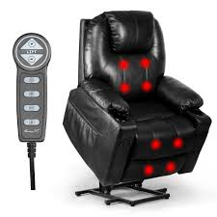
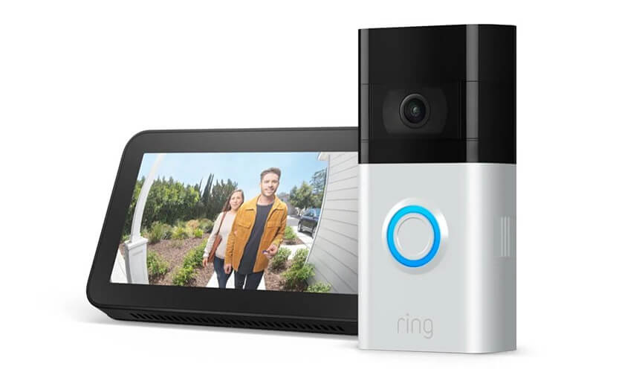
>> SLIDE 43: Common HUP Goals
Consumers had choice and control over Home Usability Program (HUP) goals
Common HUP goals included:
Recliner chairs with lifts
Ring Doorbells compatible with Amazon Echo (Alexa)

Slide 44
>> SLIDE 44: Recliner Chairs with Lifts, Heat, and/or Massage
Most common home usability goal
Why did consumers choose to get a recliner?
Need for furniture: “I had left all my furniture due to going through a bad relationship, and I had to start all over.”
Pain (need for heat/massage): “I have scoliosis of the spine, and this recliner you could use to massage your back, and they had several regions that could be massaged. One was the lower back, and that’s what was killing me.”
Lack of mobility (need for lift): “My furniture is all low. And when my Sciatica would kick in, it was just like I’m stuck. Especially if nobody was here. I'm stuck. I couldn't get around.”

Slide 45
>> SLIDE 45: Effects of Recliner Chairs
Increased Dignity: “Before, with me not being able to get up, I wet my pants one time because I couldn’t get up. But this chair, as I'm coming up, would give me that extra lift to get me moving.”
Decreased Pain: “I’m taking less of my medication now that I have the chair. Because my back would be inflamed, but the heat keeps it not inflamed. So yeah, I'm taking less medication, less pain pills.”
Increased Independence: “I can do my walks. I go to the mailbox now. Before I had my recliner, I just hoped I could get to the bathroom because I would be so inflamed. My back always hurt, 24/7. But now I have my heat.”
Increased Participation: “After I come home and I’m in the chair for 20 minutes, I can go back out into my community and do something more. Where before, I would have to come home and lay down, and try to get my body to stop aching. So yeah, it does help me to get out there.”

Slide 46
>> SLIDE 46: Ring Doorbells with Video
Why did consumers choose to get a Ring Doorbell with Video?
Safety concerns: “There is increased crime rate in the metropolitan area where I live, and I feel a bit safer because the area is being videotaped.”
Home security concerns: “Whenever I’m out with my friends or my family, I want make sure that my home base is still protected whenever I leave.”
Mobility concerns: “I love having the option for the like the ring doorbell thing that I got through the program because I don't have like even at the house, it was a long run to the front door and I'm upstairs whereas if somebody rings the doorbell you know I can just talk to them through my phone and I don't have to go there and I don't have to go downstairs.”

Slide 47
>> SLIDE 47: Effects of Ring Doorbells
Increased Sense of Safety: “I feel safer knowing maybe camera will catch next person who runs into my gate with their vehicle.”
Increased Sense of Home Security: “I still do the same things, in fact, I do it a lot more comfortably. It’s given me a lot more time to be more in tune with my surroundings, and with the community whenever I do interact with people.”
Decreased Exertion: “With the doorbell, I don't have to be face-to-face coming to the door. It could be communication through the camera. It could be, ‘Oh, yeah, I see you with the package. Just leave it there. Yeah, I'm getting my son to come get it.’ And so that it means I don't have to use the energy to go to the door and open it to find out who's on the other side of it. And I can make decisions about when I need to go to the door. Like how quick to get there.”

Slide 48
>> SLIDE 48: If Money Were No Object
Need for one-story home and increased space for maneuverability: “I would level the whole thing. I’d burn it down to the ground, remodel the whole thing, make it bigger. Make it wider. Make the bedrooms a little bit bigger. I’d make everything bigger. I would not have [narrow] doors. I would have all 36 in.”
Need for increased space for assistive technology & durable medical equipment: “I want a two-bedroom. I need a two-bedroom because I have [assistive technology]. I have a lot of equipment. I have a lot of oxygen tanks and stuff all over, and I don’t have enough room.”
Need to address risk of fall/injury: “I want a new refrigerator. My refrigerator is horrible. I make it work, but getting my hands and knees to get something out of the fridge is not ideal for me. I've made it work for almost eight years.”
Need to address basic needs: “I’m in an attic space, so, I would probably put a dedicated AC/heating unit up there.”

Slide 49
>> SLIDE 49: Common OAA Goals
Consumers had choice and control over Out and About (OAA) goals
Common HUP goals included:
Accessing and learning to use technology
Exercising

Slide 50
>> SLIDE 50: Setting Goals to Access and Learn to Use Technology
Why did consumers choose a goal to access and learn to use technology?
Lack of access to information: “I guess I was just like a caveman. I didn’t know what was happening in the world.”
Lack of delivery options: “[Grocery shopping] took me forever. I get lost easy… I used to walk the supermarket without a mask to pick up my stuff probably three times a week.”
Isolation: “With COVID, when I was restricted to the house, I didn't have work to see people, and I was not allowed out of the house. So, it was a nightmare for an entire year.”
Lack of community participation: “I used to go to the movies at least once a month, before COVID. I haven't been to the movies to this day once COVID started. So that would be a nice thing to get to bump into people.”

Slide 51
>> SLIDE 51: Effects of Using Technology
Increased Access to Information: “It enables me to do research and look up things when I can't get to the library. It just makes it easier for me to do things that I can't normally get to.”
Increased Delivery Options: “The computer changed the way that I can order stuff [online] like my groceries.”
Increased Connection to Friends/Family: “Since the pandemic, the computer has been a big help because I can do a Zoom call like I did for my sister's birthday. That helped a lot. We did a Zoom call. Everybody was at their house. And all of us wished my sister happy birthday through a Zoom call. She was shocked.”
Community Participation from Home: “My church offers virtual, so I learned how to go virtually to be able to keep up with the church service.”

Slide 52
>> SLIDE 52: Setting Goals to Exercise
Why did consumers choose a goal to exercise?
Weight loss: “And it was my fault for not getting out to walk at least the six blocks to the park and six blocks back so that I add more steps so that I level off my weight. Right now, I’m fighting the weight. I'm on a diet, low calorie diet so that I'm able to stabilize my weight, but I need to lose more weight.”
Mobility concerns: “The week before COVID started shutting everything down, I unexpectedly developed severe arthritis in my right knee, which is my good side. So, my ability to support my own weight to transfer into a driver's seat and to drive with that leg changes by day.”

Slide 53
>> SLIDE 53: Effects of Exercising
Increased Mobility: “It's all about keeping keeping my body in shape and being able to maneuver in and out of my apartment, in and out of my wheelchair. Being able to move from my wheelchair to a seat with no issues. I feel the more the more I work out, the less strain that I have to deal with.”
Increased Community Participation: “From walking and doing my route, I was like, well, if I can do the mile this way, I can probably just keep going and I can get to this Publix, or up to this Kroger. Or I can walk to the Trader Joe's to grab a few things. Kind of exploring the neighborhood a little more and finding some different areas to hang around in. I found a couple of little parks I've never seen before, and I've lived in that area for a very long time. I was like, oh look, a little park, there's a pond, let me hang out there for a bit. So, it was good in that respect to explore the community and kind of grow some of the routes that I would memorize and take.”

Slide 54
>> SLIDE 54: PICL Takeaways
“The best thing to come out of [the PICL program] is just me finding a sense of confidence and well-being. Knowing that you can make a change, it doesn’t take long. I mean, the saying goes, ‘It takes 21 days to form a habit.’ And I’m happy that I made a habit from being a part of this program.”
“[I have] more self-esteem. The program just gives you a little bit of confidence and makes sure you feel better about yourself and don’t focus so much on the disability.”
“I didn’t really think people really gave much of a damn with people with impairments like that. That deeply, of course. So, I really learned that there are some very genuinely authentic people out there that really do. I really enjoyed building the bond that I had with [my CIL staff] over these past few months, so I really do appreciate that.”

Slide 55
>> SLIDE 55
Questions?

